Slide 1
Cloud Storage with AWS
Notes:
https://courses.cs.washington.edu/courses/cse403/13au/lectures/git.ppt.pdf
http://enos.itcollege.ee/~jpoial/allalaadimised/git/getting-started-with-git.pdf

Slide 2

AWS S3 (Simple Storage Service) Overview
S3 - Simple Storage Service
It’s advertised as ”infinitely scaling” storage
Many websites use Amazon S3 as a backbone
Amazon S3 allows people to store objects (files) in “buckets” (directories)
Buckets must have a globally unique name

Slide 3
Amazon S3 Overview - Objects
Objects (files) have a Key
The key is the FULL path:
s3://my-bucket/my_file.txt
s3://my-bucket/my_folder1/another_folder/my_file.txt
The key is composed of prefix + object name
s3://my-bucket/my_folder1/another_folder/my_file.txt

Slide 4
Hands-On: Create Bucket and upload files

Slide 5
Amazon S3 -Versioning
You can version your files in Amazon S3
It is enabled at the bucket level
Same key overwrite will increment the “version”: 1, 2, 3….
It is best practice to version your buckets
Protect against unintended deletes (ability to restore a version)
Easy roll back to previous version
Any file that is not versioned prior to enabling versioning will have version “null”
Suspending versioning does not delete the previous versions

Slide 6
Hands-On: Applying Version Control

Slide 7
S3 Security
User based
IAM policies - which API calls should be allowed for a specific user from IAM console
Resource Based
Bucket Policies - bucket wide rules from the S3 console - allows cross account
Object Access Control List (ACL) – finer grain
Bucket Access Control List (ACL) – less common

Slide 8
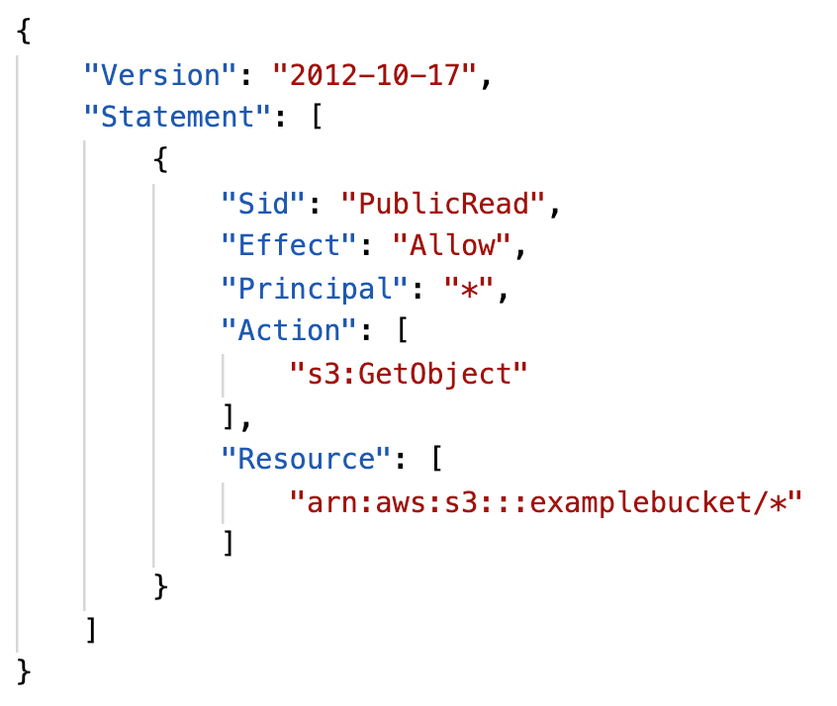
S3 Bucket Policies
JSON based policies
Resources: buckets and objects
Actions: Set of API to Allow or Deny
Effect: Allow / Deny
Principal: The account or user to apply the policy to
Use S3 bucket for policy to:
Grant public access to the bucket
Force objects to be encrypted at upload
Grant access to another account (Cross Account)

Slide 9
Hands-On: Bucket Policy

Slide 10
Bucket settings for Block Public Access
Block public access to buckets and objects granted
Block public and cross-account access to buckets and objects through any public bucket or access point policies
These settings were created to prevent company data leaks
If you know your bucket should never be public, leave these on
Can be set at the account level

Slide 11
Hands-On: Block Public Access
Also set at the account level

Slide 12
S3 Websites
S3 can host static websites and have them accessible on the www
The website URL will be:
<bucket-name>.s3-website-<AWS-region>.amazonaws.com
OR
<bucket-name>.s3-website.<AWS-region>.amazonaws.com
If you get a 403 (Forbidden) error, make sure the bucket policy allows public reads!

Slide 13
Hands-On: Static website hosting using S3

Slide 14
Glacier Overview
Low cost object storage meant for archiving / backup
Data is retained for the longer term (10s of years)
Alternative to on-premise magnetic tape storage
Average annual durability is 99.999999999%
Cost per storage per month ($0.004 / GB) + retrieval cost
Each item in Glacier is called “Archive” (up to 40TB)
Archives are stored in ”Vaults”

Slide 15
Amazon Glacier – 3 retrieval options
Amazon Glacier – 3 retrieval options:
Expedited (1 to 5 minutes)
Standard (3 to 5 hours)
Bulk (5 to 12 hours)
Minimum storage duration of 90 days

Slide 16
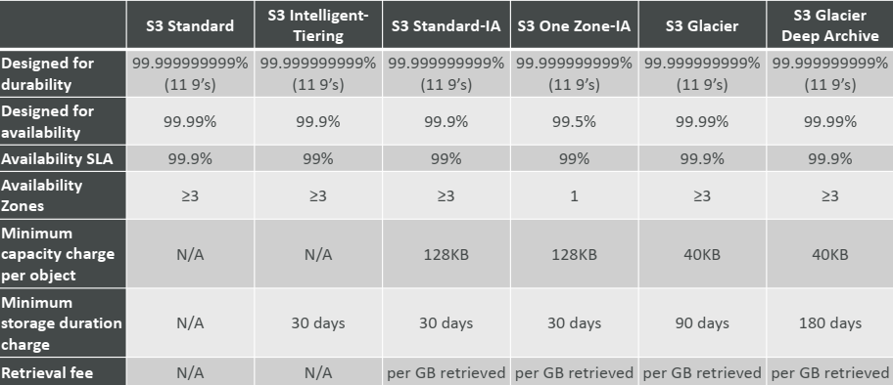
S3 Storage Classes Comparison

Slide 17
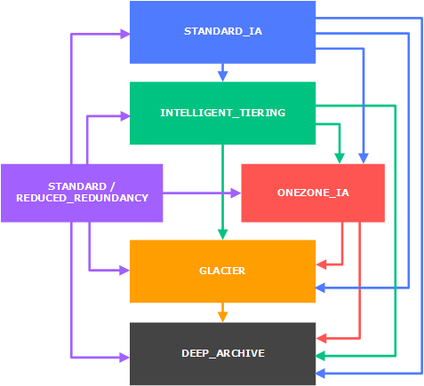
S3 – Moving between storage classes
You can transition objects between storage classes
For infrequently accessed object, move them to STANDARD_IA
For archive objects you don’t need in real-time, GLACIER or DEEP_ARCHIVE
Moving objects can be automated using a lifecycle configuration

Slide 18
S3 Lifecycle Rules
Transition actions: It defines when objects are transitioned to another storage
class.
Move objects to Standard IA class 60 days after creation
Move to Glacier for archiving after 6 months
Expiration actions: configure objects to expire (delete) after some time
Access log files can be set to delete after a 365 days
Can be used to delete old versions of files (if versioning is enabled)
Can be used to delete incomplete multi-part uploads
Rules can be created for a certain prefix (ex - s3://mybucket/mp3/*)
Rules can be created for certain objects tags (ex - Department: Finance)

Slide 19
S3 Lifecycle Rules – Scenario
Your application on EC2 creates images thumbnails after profile photos are uploaded to Amazon S3. These thumbnails can be easily recreated, and only need to be kept for 45 days. The source images should be able to be immediately retrieved for these 45 days, and afterwards, the user can wait up to 6 hours. How would you design this?
S3 source images can be on STANDARD, with a lifecycle configuration to transition them to GLACIER after 45 days.
S3 thumbnails can be on ONEZONE_IA, with a lifecycle configuration to expire them (delete them) after 45 days.

Slide 20
Hands-On: Implement Scenario 1

Slide 21
S3 Lifecycle Rules – Scenario 2
A rule in your company states that you should be able to recover your deleted S3 objects immediately for 15 days, although this may happen rarely. After this time, and for up to 365 days, deleted objects should be recoverable within 48 hours.
You need to enable S3 versioning in order to have object versions, so that “deleted objects” are in fact hidden by a “delete marker” and can be recovered
You can transition these “noncurrent versions” of the object to S3_IA
You can transition afterwards these “noncurrent versions” to DEEP_ARCHIVE

Slide 22
Assignment: Implement Scenario 2

Slide 23
EBS Overview

Slide 24

EBS Overview
An EC2 machine loses its root volume (main drive) when it is manually terminated.
Unexpected terminations might happen from time to time
Sometimes, you need a way to store your instance data somewhere
An EBS (Elastic Block Store) Volume is a network drive you can attach to your instances while they run
It allows your instances to persist data

Slide 25
EBS Volume
It’s a network drive (i.e. not a physical drive)
It’s locked to an Availability Zone (AZ)
An EBS Volume in us-east-1a cannot be attached to us-east-1b
To move a volume across, you first need to snapshot it
Have a provisioned capacity (size in GBs, and IOPS)

Slide 26
Hands-On: Create and Attach EBS Volume

Slide 27
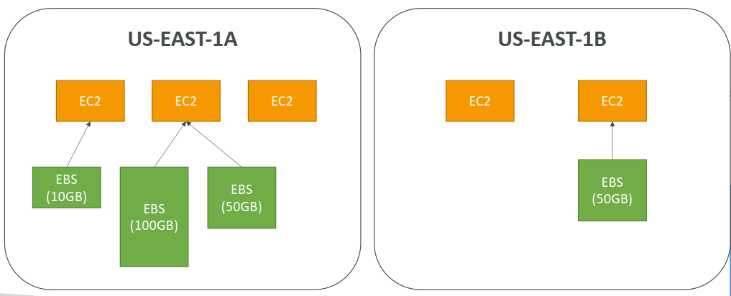
EBS Volume Example

Slide 28
EBS –Volume Types
gp2: General Purpose Volumes (cheap)
3 IOPS / GiB, minimum 100 IOPS, burst to 3000 IOPS, max 16000 IOPS
1 GiB – 16TiB , +1 TB = +3000 IOPS
io1: Provisioned IOPS (expensive)
Min 100 IOPS, Max 64000 IOPS (Nitro) or 32000 (other)
4 GiB - 16TiB. Size of volume and IOPS are independent
st1: Throughput Optimized HDD
500 GiB – 16TiB , 500 MiB /s throughput
sc1: Cold HDD, Infrequently accessed data
500 GiB – 16TiB , 250 MiB /s throughput

Slide 29
EBS vs Instance Store
Some instance do not come with Root EBS volumes
Instead, they come with “Instance Store” (= ephemeral storage)
Instance store is physically attached to the machine (EBS is a network drive)
Pros:
Better I/O performance (EBS gp2 has an max IOPS of 16000, io1 of 64000)
Good for buffer / cache / scratch data / temporary content
Data survives reboots
Cons:
On stop or termination, the instance store is lost
You can’t resize the instance store
Backups must be operated by the user

Slide 30
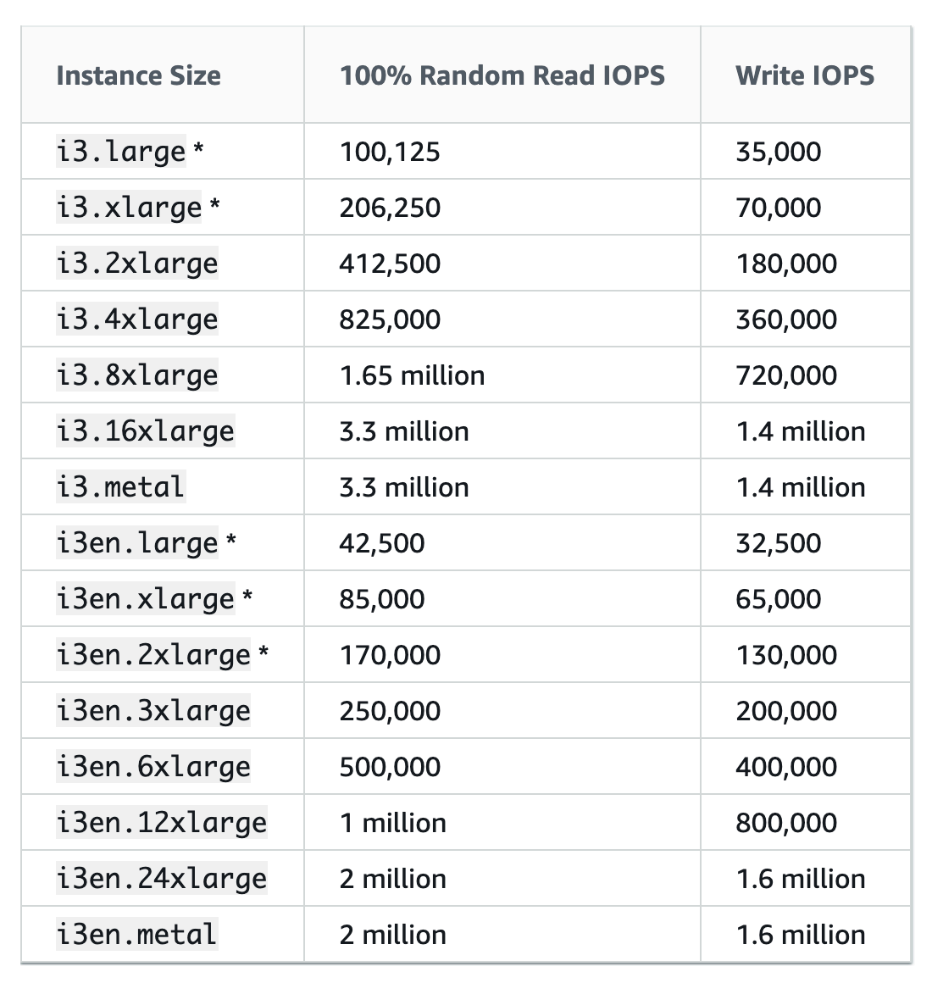
EC2 Instance Store

Slide 31
Assignment: Create EC2 using Instance Store

Slide 32
EFS – Elastic File System

Slide 33
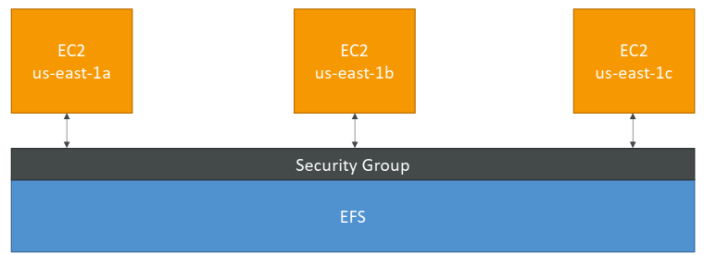
EFS – Elastic File System
Managed NFS (network file system) that can be mounted on many EC2
EFS works with EC2 instances in multi-AZ
Highly available, scalable, expensive (3x gp2), pay per use

Slide 34
EFS – Elastic File System
Use cases: content management, web serving, data sharing,Wordpress
Uses NFSv4.1 protocol
Compatible with Linux based AMI (not Windows)
File system scales automatically, pay-per-use, no capacity planning!

Slide 35
Hands-On: Create EFS
First Create EFS using AWS Portal
Commands for Mounting
sudo apt install amazon-efs-utils
sudo mount -t efs -o tls fs-7ad35202:/ efs
Make sure to edit security group of EFS to allow incoming NSF traffic from security group associated to the instance onto which we want to mount EFS.

Slide 36
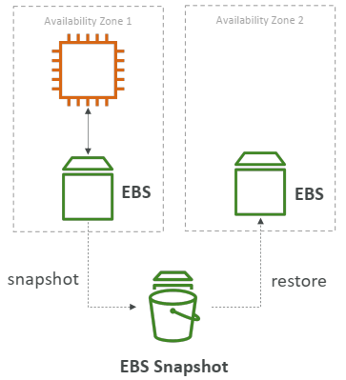
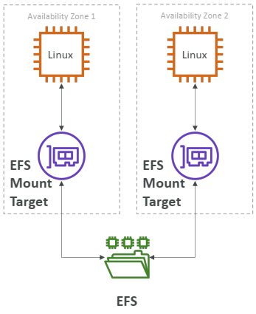
EBS vs EFS

Slide 37
Storage Gateway Overview

Slide 38
Storage Gateway Overview
To securely backup enterprise data to the cloud
Pay as you go pricing
Only pay for the storage we actually use
A hybrid cloud storage service that gives you on-premises access to virtually unlimited cloud storage
Also integrates natively with Amazon S3 cloud storage which makes your data available for in cloud processing

Slide 39
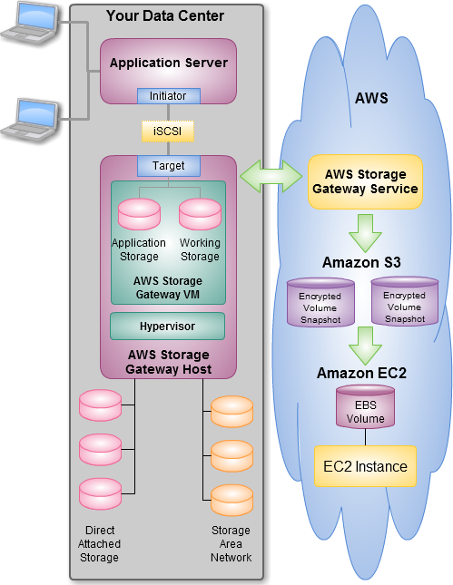
Storage Gateway Overview

Slide 40
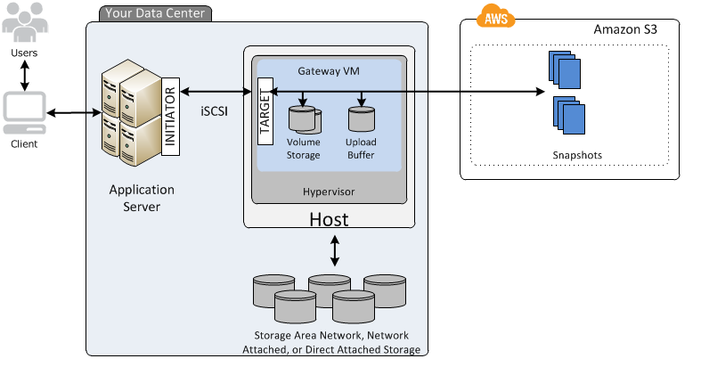
Storage Gateway Overview

Slide 41
Thanks

